Slide 1
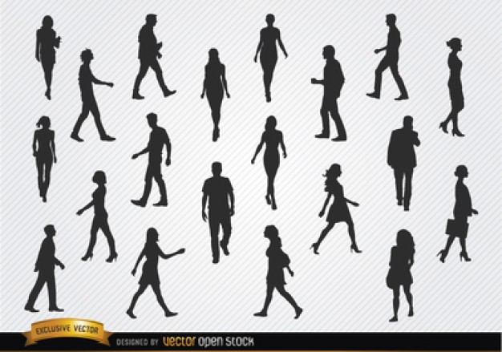
Human Activity Recognition
Anurag Bhatt

Slide 2
Visualizing the data
Some python codes to have easy access to raw data
One activity for all people
A specific activity for a specific person
All activities for a single person

Slide 3
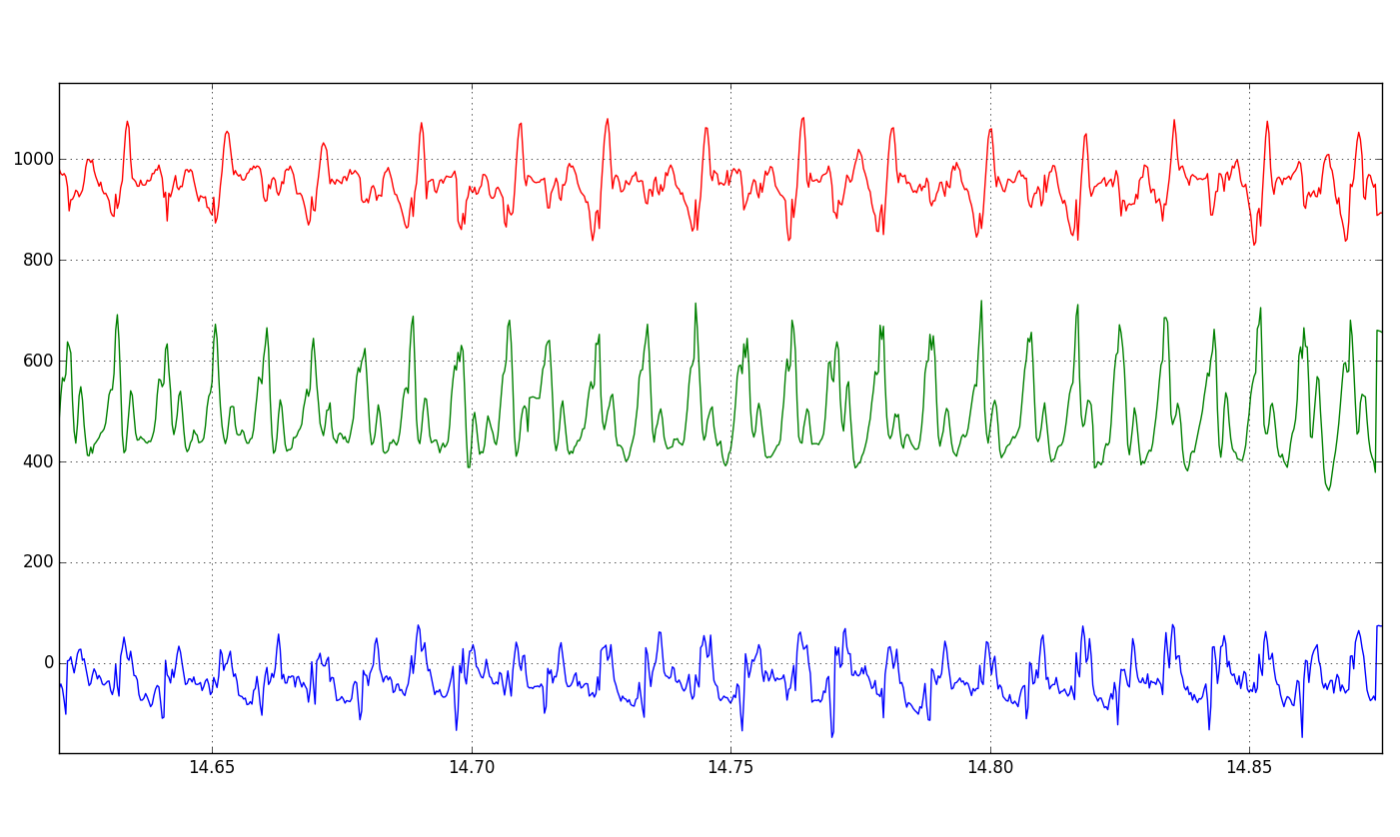
Frame work of analysis
Looking at an activity as the outcome of a basic process inherent to the individual
Each step of an individual differs from the rest of his steps, yet is essentially the same in some underlying way
Observed = pure + error

Slide 4
Choose the window
Frequency of the machine
Extract features within the window
Identify meaningful features
Compare and contrast based on the features
Basic plotting
Overlapping window – 50% optimal
(from the papers)
Min-max amplitude
Rms value
Energy
Mean
Finding a separating hyper-plane
See if separable clusters can be seen
Clustering algorithms

Slide 5
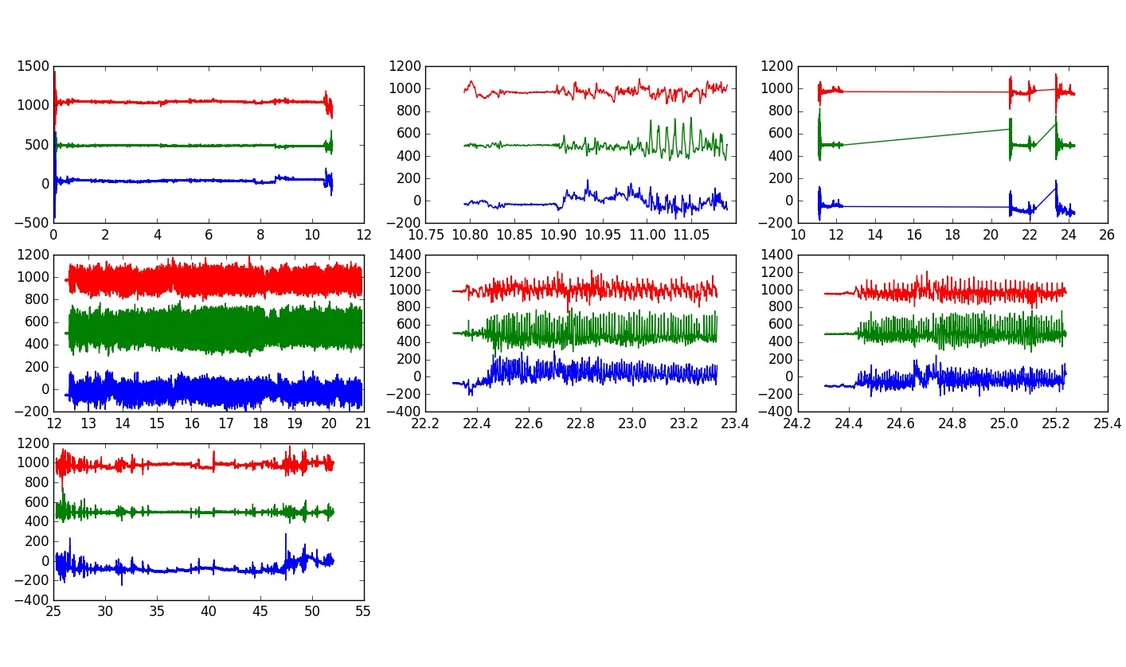
Difference between activities - visualizing
One person, all activities
One person, pure activities
1 : Desk work
2 : Stand + Walk + Stairs
3 : Stand
4 : Walk
5 : Stairs
6 : Walk + Talk
7 : Talk

Slide 6
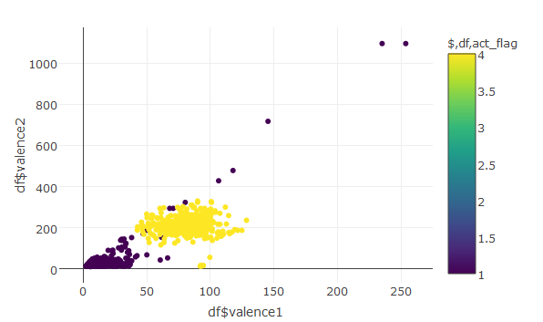
Feature clustering
Separate clusters for activities that are significantly different as per the features used

Slide 7
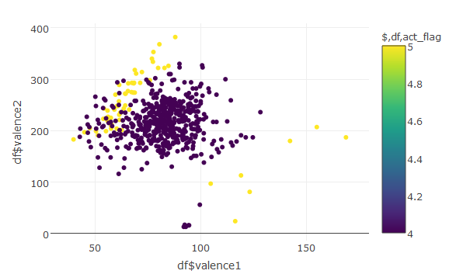
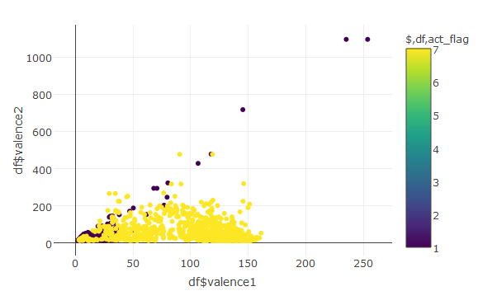
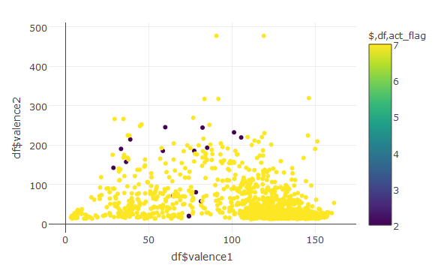
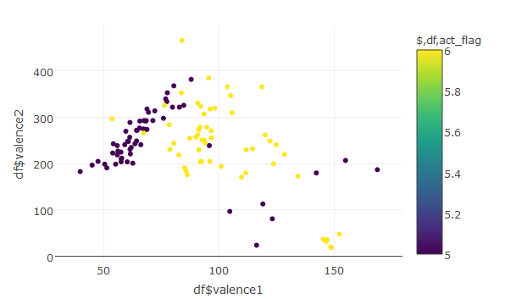
Valence1 = RMS value; Valence2 = MinMax

Slide 8
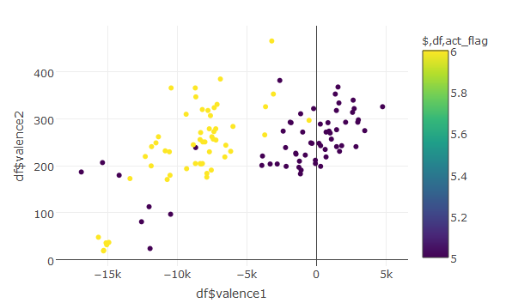
Changing features makes indistinguishable activities as distinguishable
Valence1 = MinMax
Valence2 = RMS
Valence1 = MinMax
Valence2 = Energy

Slide 9
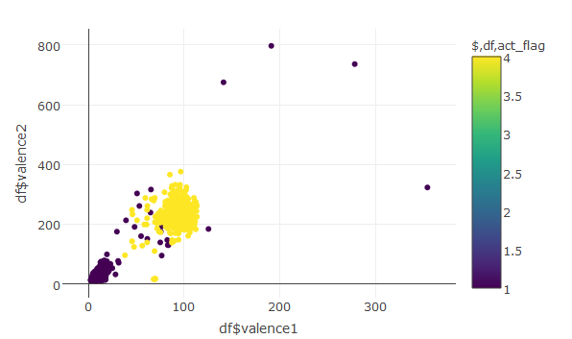
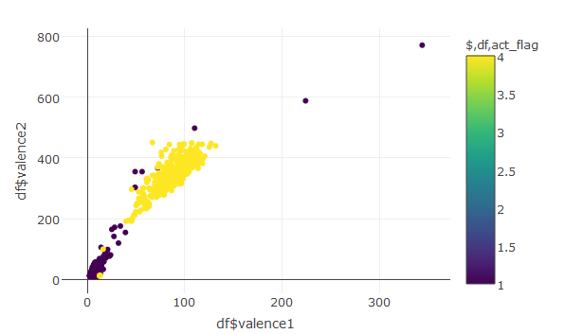
Activities with max difference

Slide 10
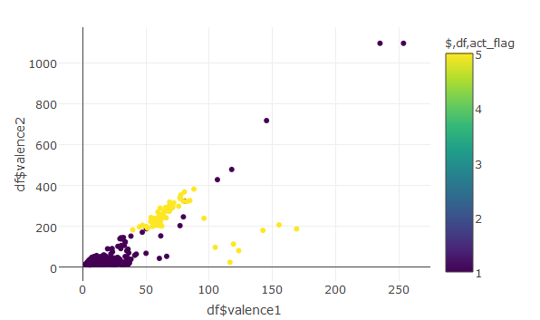
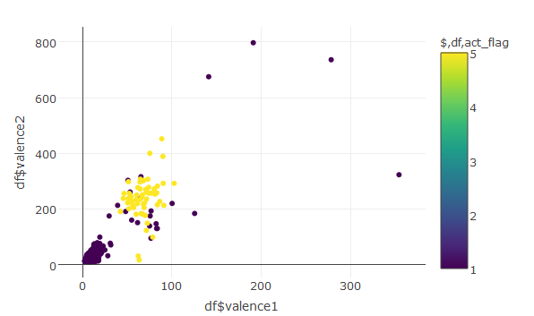
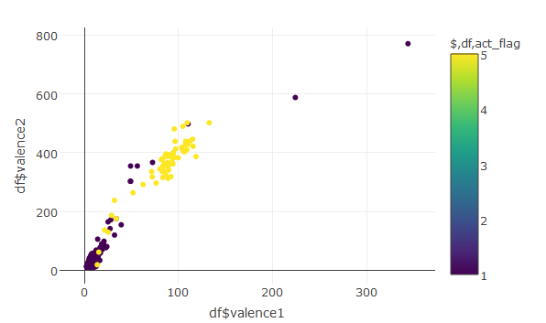
Measure of distance – Euclidean distance between centroid of the clusters

